Slide 1

A
Seminar Report
On
“Hotel Management System”
(MCA - 507)
Submitted in partial fulfillment for the requirement for the
Master of Computer Applications
Semester : MCA V
From
Pt. Ravishankar Shukla University, Raipur (C.G)
Session: 2020122
Guided By:-
Mr. Deepak Deshmukh
(Ass. Professor)
Submitted By:-
Megha Rao
Roll No. 1910174011
Submitted to
S.o.S. in Computer Science & I.T.
Pt. Ravishankar Shukla University, Raipur (C.G.)

Slide 2
Contents
Introduction
Objective
Module Description
Software and Hardware Requirements
Data Flow diagram
Flowchart
Entity relationship Diagram
Database Design
Front-end design
Backend
Report
Advantages
Disadvantages
Conclusion

Slide 3
Introduction
The hotel management system is developed for hotels that are using a manual system to handle hotel processes. This system will automate the major operations of the hotel. Hotel Management project for keeping customers’ and staff records. The Room module is for managing all room types of room services, helping the user to keep track of all information of hotel rooms. It manages all checked In and Checked Out Records.
The main objective of the entire activity is to automate the process of day-to-day activities of the Hotel. Using this system you can manage room activities and keep track of the admission of a New Customer. Using this system you can check rooms according to customers’ needs and can assign easily room to customers. Checkout of a customer and updating the releasing room information in the system is very easy. When the user does checkout. Hotel management can also check the list of Regular customers.

Slide 4
Objective
The main purpose of the project “Hotel Management system” is to make the smooth & effective work. This module makes the computerized “Management of customer’s (Guest) Records ”.
The company to effectively manage their Hotel business.
To Transform the manual process of renting a house into a computerized system.
To produce the documentation such as Software Requirement Specification, Software Design Description, and Software Development References.
Easy to maintain in future prospects.

Slide 5
Hardware and Software Requirment
The following are the minimum requirement for running of the program:- Hardware:- Microprocessor- Pentium 1 of higher Drive-Any of the external write able drive (for setup of the package also to take regular backup) HDD- Min 1GB (for operating system & program to setup Properly) RAM- 1 GB (Min.) Display- HDMI/VGA or higher Key Board- 84/109 keys Mouse- Any standard Mouse Printer- 80/132 cols.

Slide 6
Software:-
Operating system- Windows 7, 8 or Higher RDBMS- Microsoft Access GUI Tool – Visual studio 2010 Front-end:- .Net Framework Backend: - Microsoft Access 2007

Slide 7
Modules
Login Form - Authenticated users login through this module.
Splash Screen Form – It shows the Project Name and Developer’s Name.
Home Screen Form - It contain all the other modules.
Add Staff Form - It adds new staff details (Records).
Add Customer Form - It adds new guest.
Add Room Form– It select Room number and status according to guest demand.
CheckedIn Form – User enters guest’s checkedIn details.
CheckedOut Form – User enters guest’s checkedOut details.
CheckedIn List Form – It displays guest’s checkedIn Records.
CheckedOut Form – It displays guest’s checkedOut Records.

Slide 8
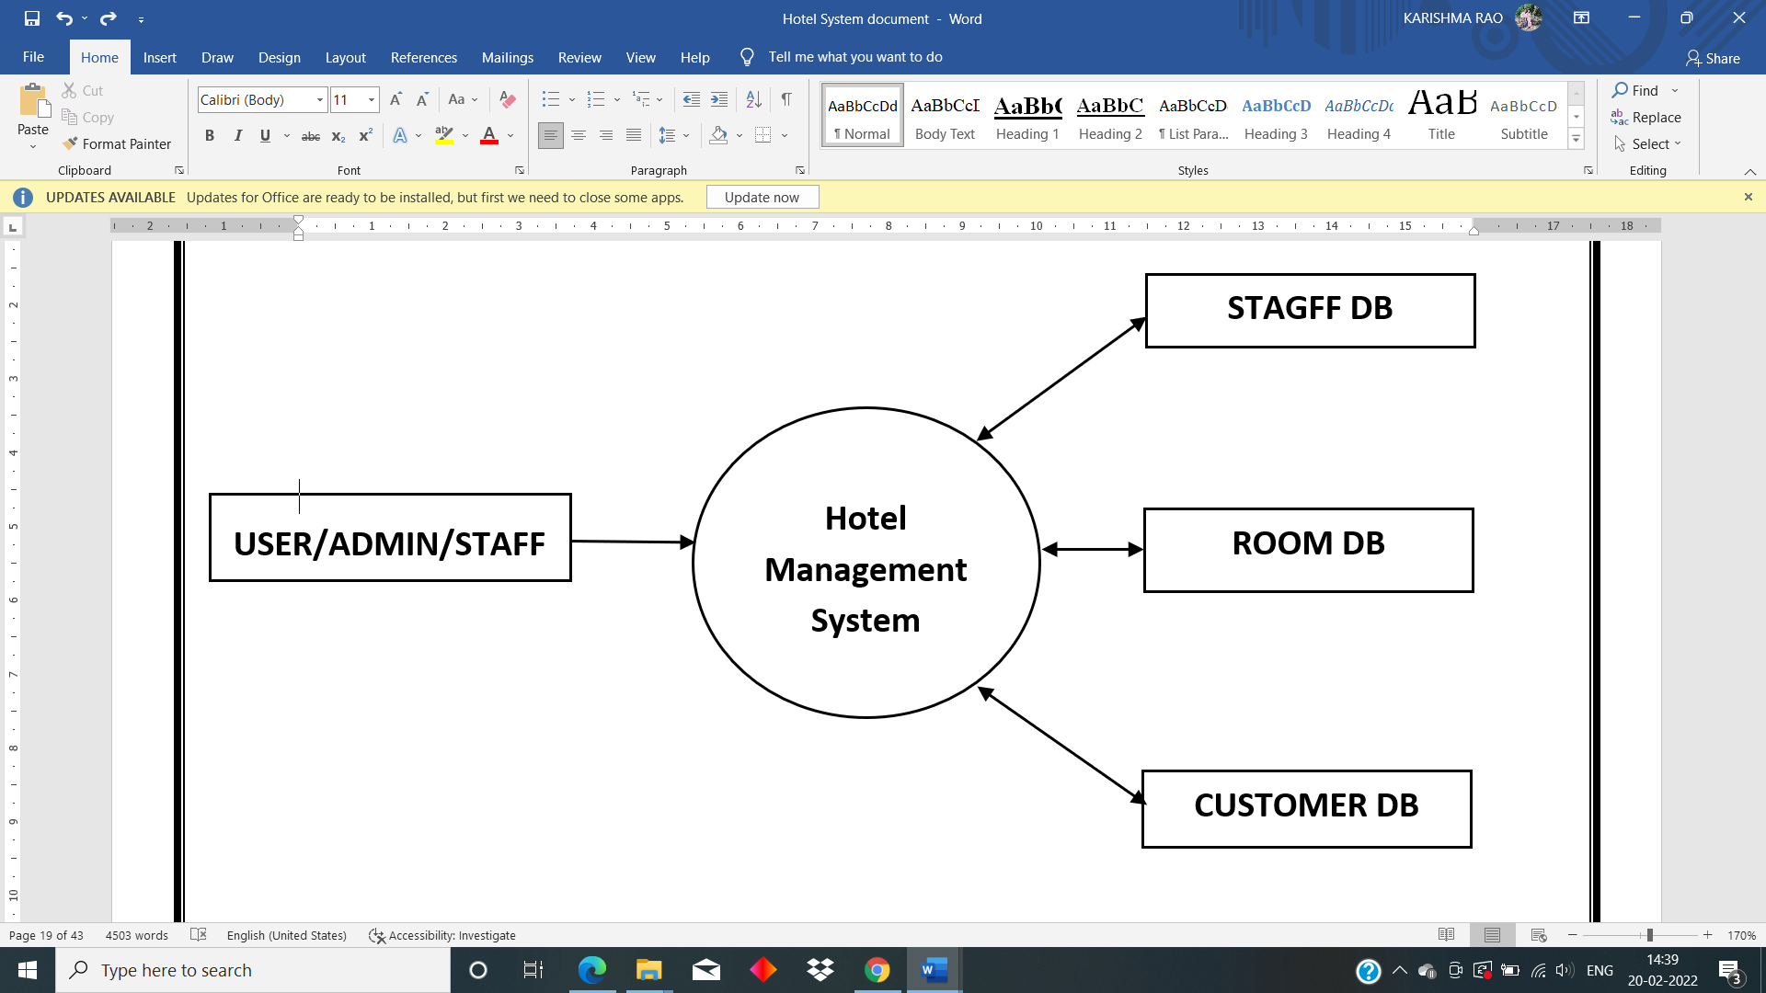
Dataflow Diagram
0 LEVEL

Slide 9
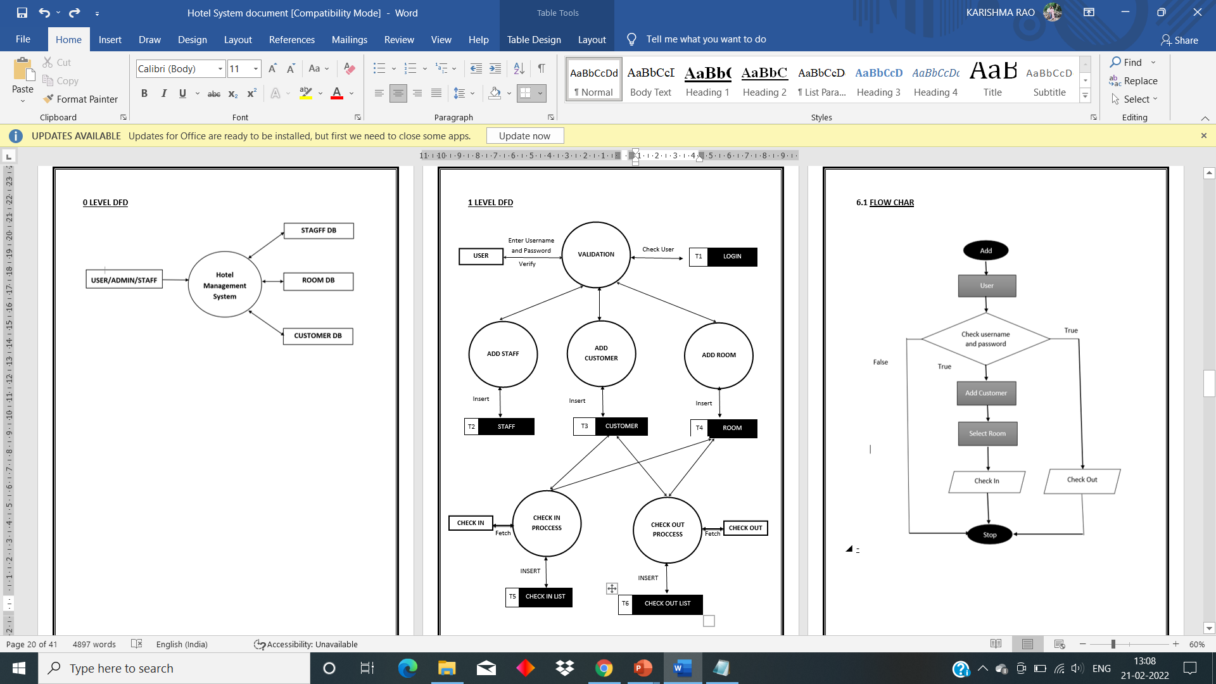
1 LEVEL

Slide 10
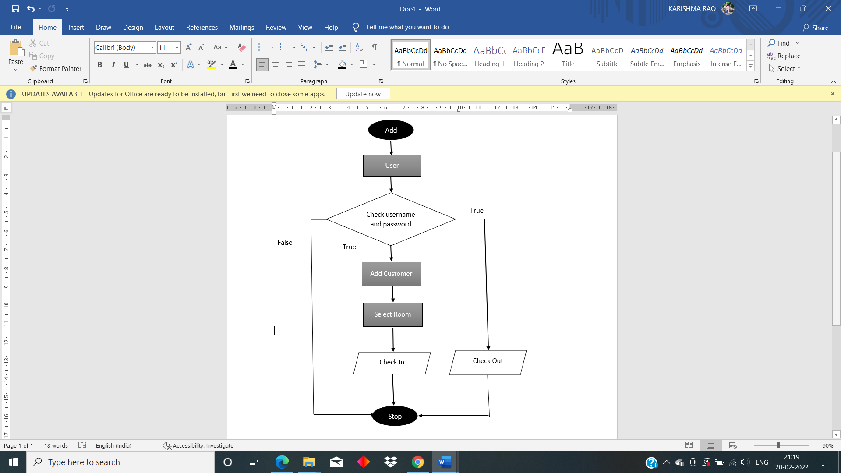
Flowchart

Slide 11
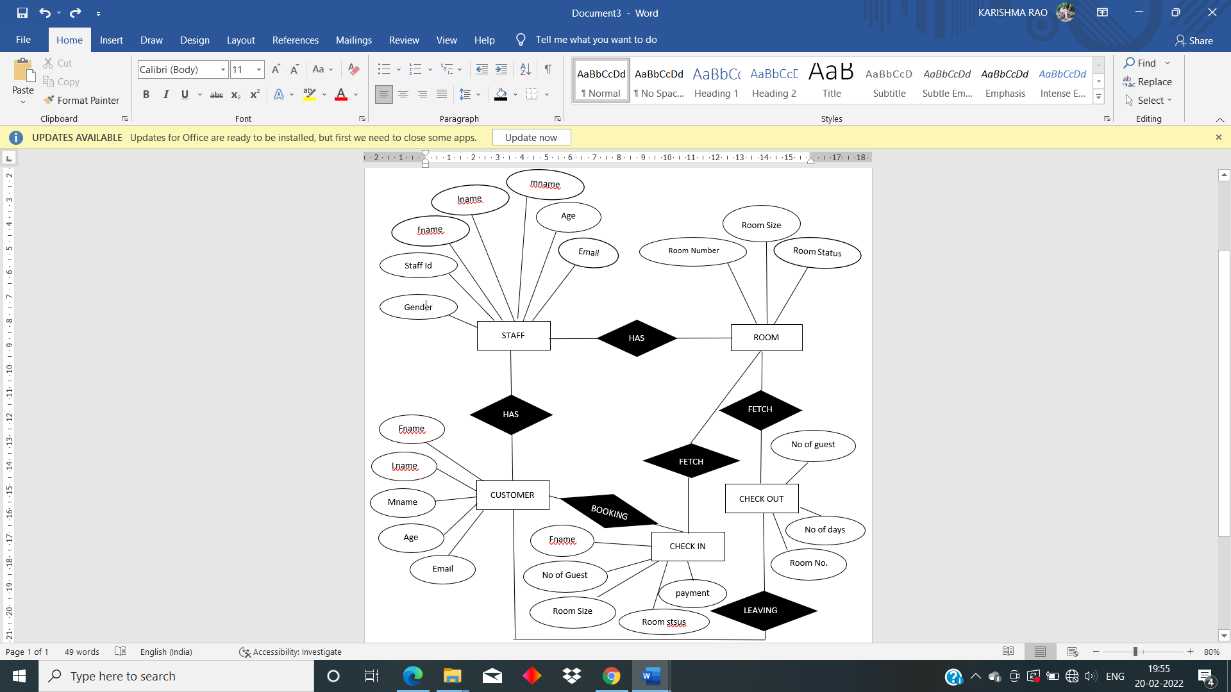
Entity Relatonship Model

Slide 12
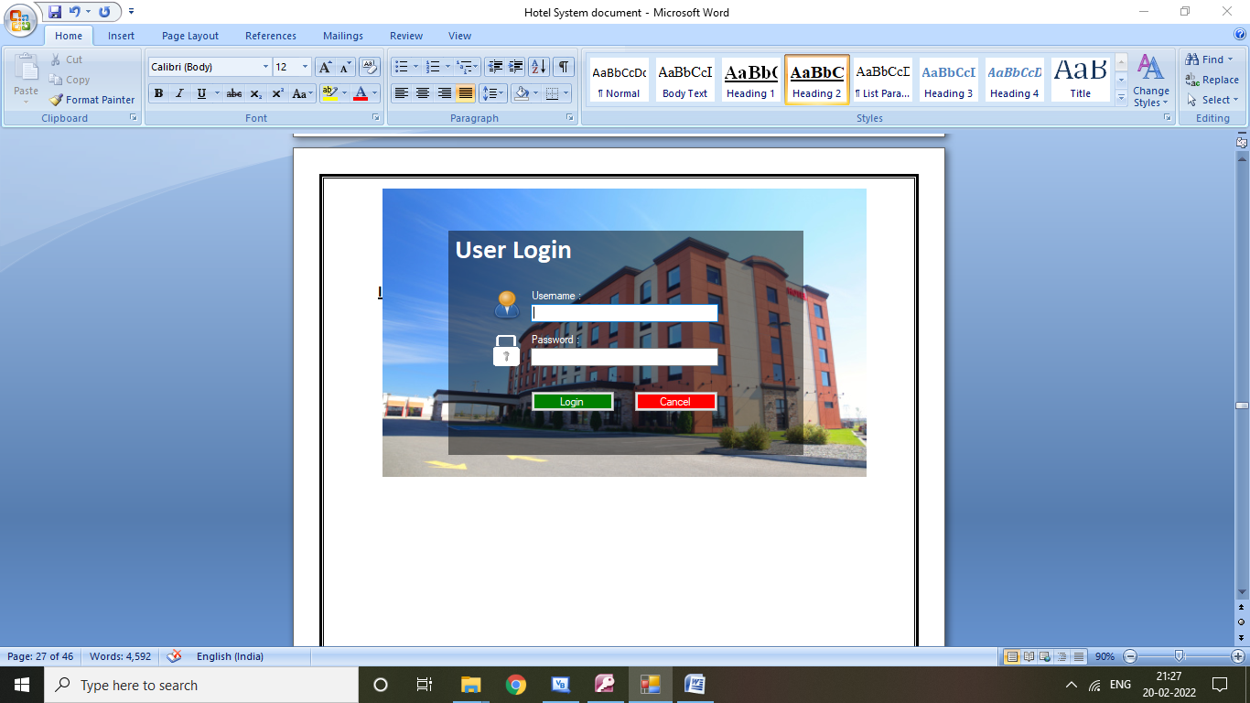
INPUT-OUTPUT SCREEN
Login Form - Authenticated users login through this module.

Slide 13
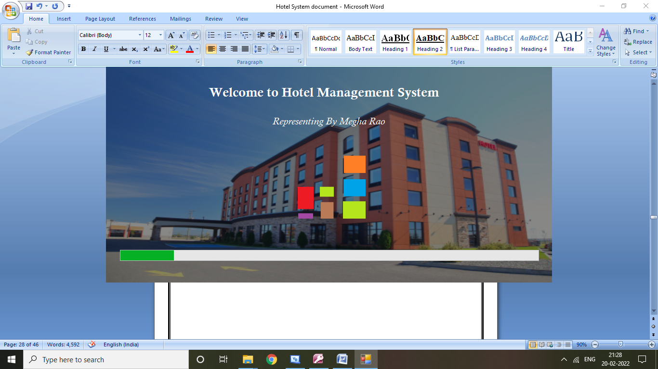
Splash Screen Form

Slide 14
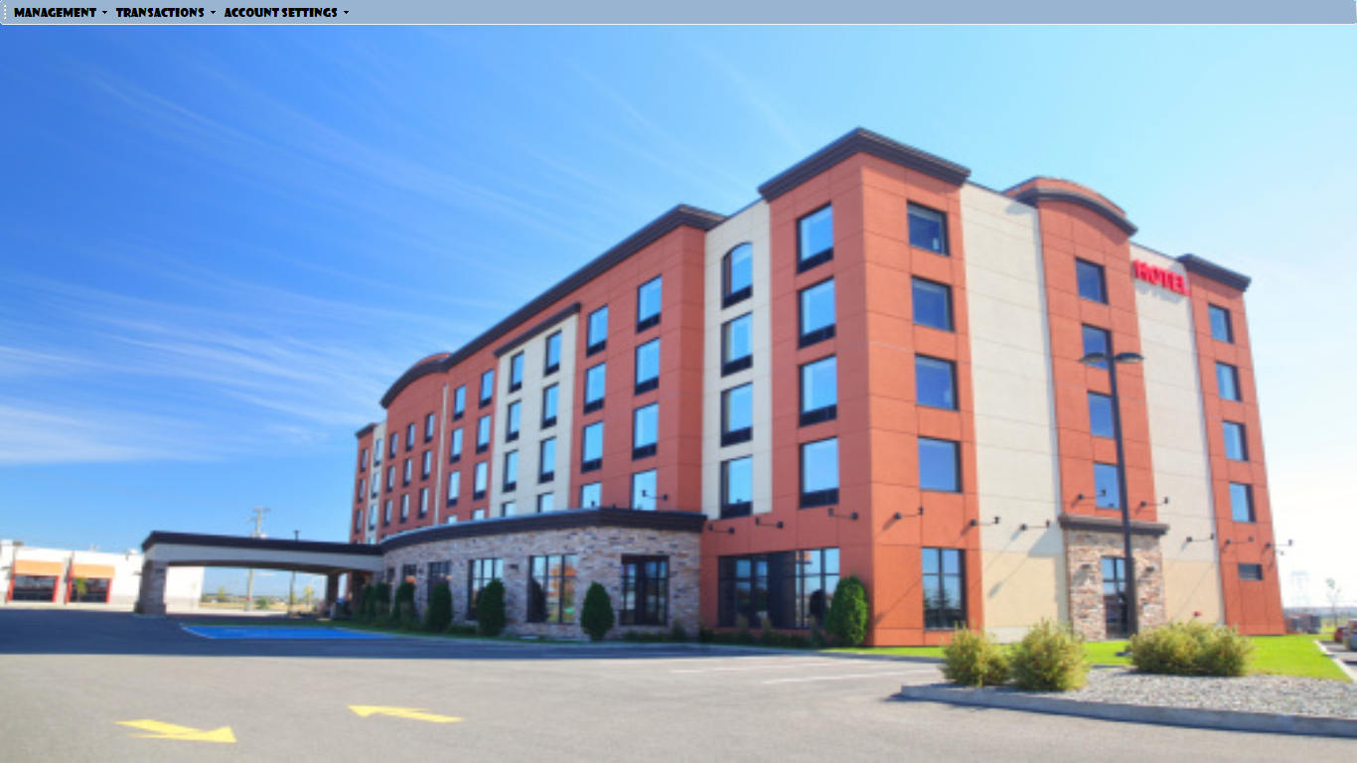
Home Screen Form - It contain all the other modules.

Slide 15
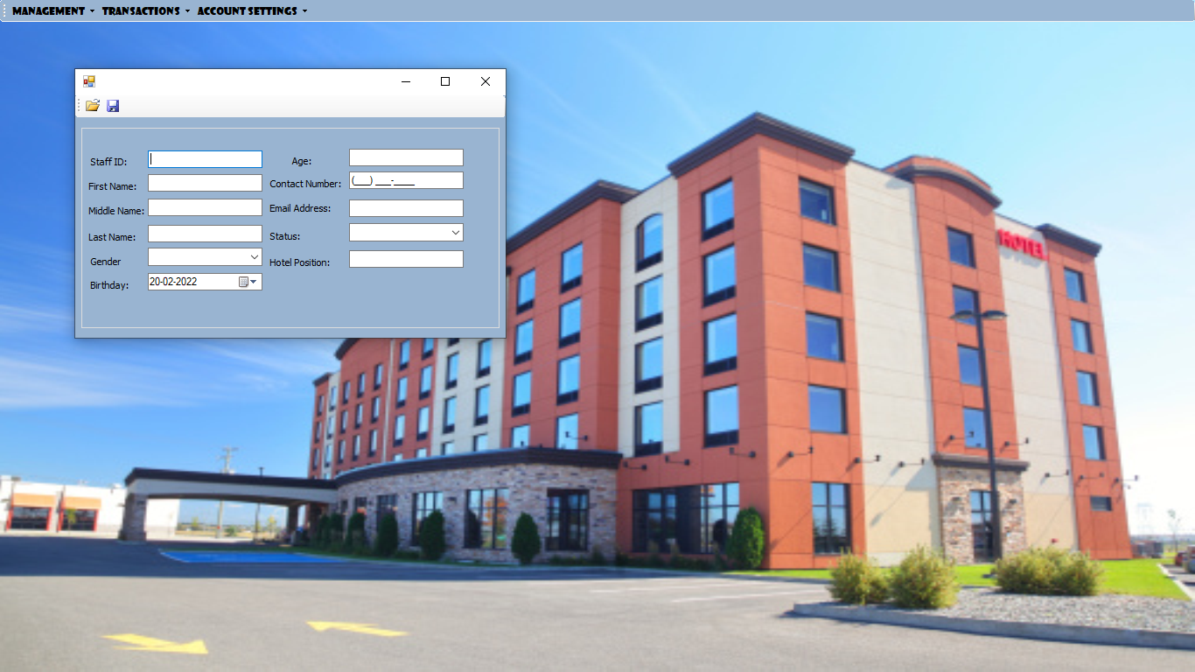
Add Staff Form - It contain all the other modules.

Slide 16
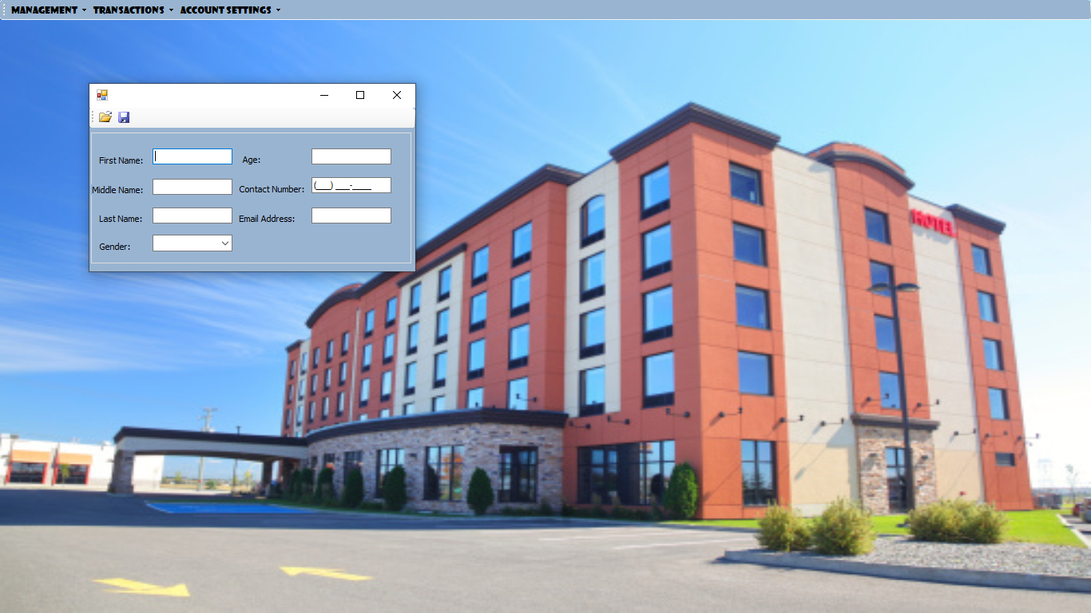
Add Customer – It adds new Customer’s Records.

Slide 17
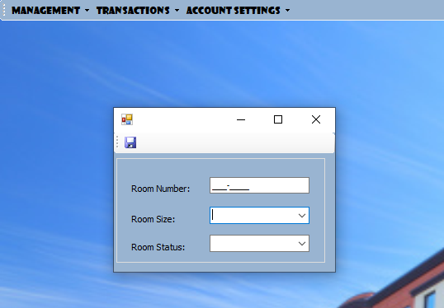
Add Room Form – It selects room status and room type.

Slide 18
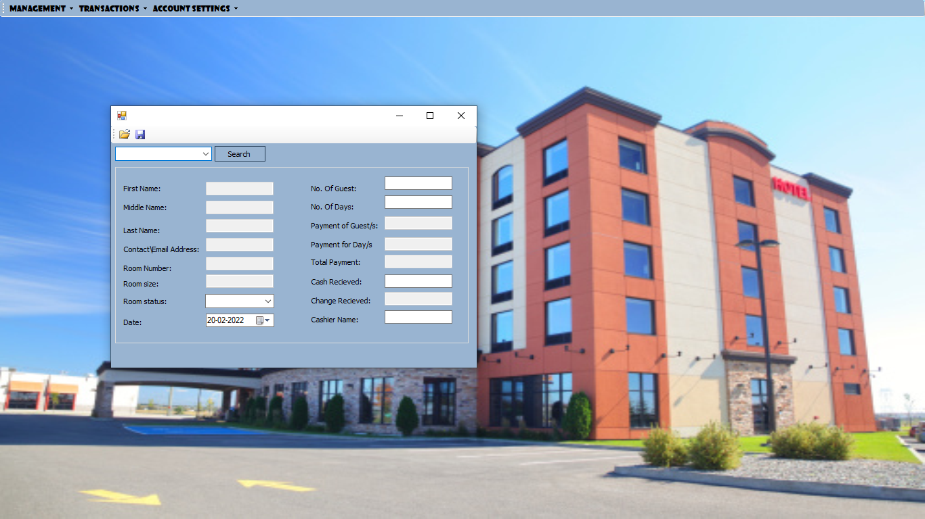
Checked In Form – It Fetches guest record and room number details from the database, And stores Checked-In Records of customers (guests).

Slide 19
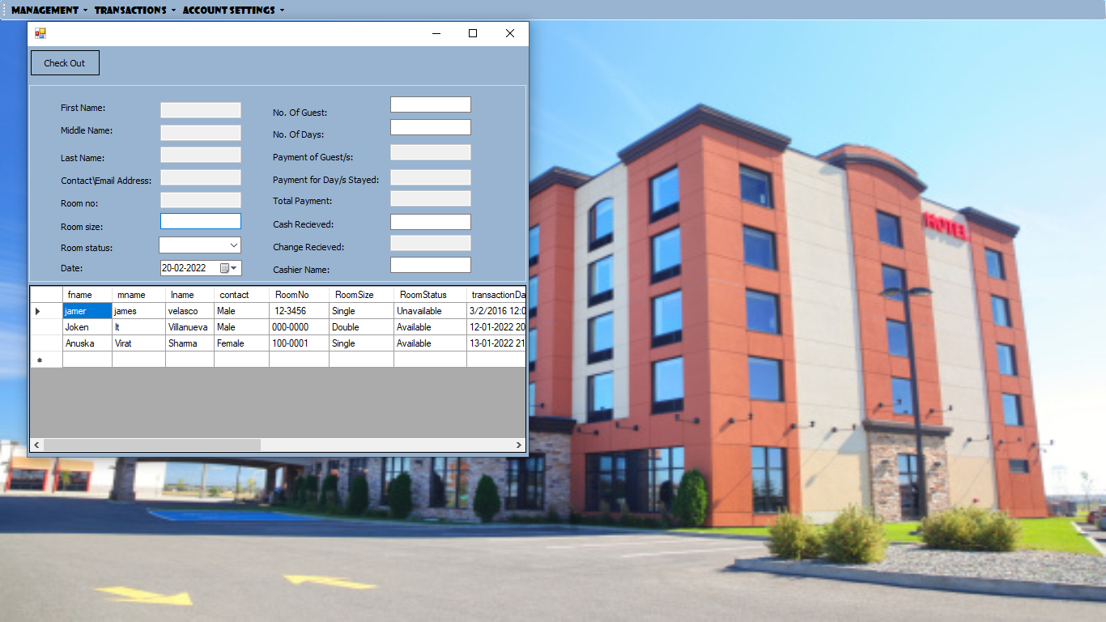
Check Out Form – It Fetch guest record and room number details from database, And store Check Out Record of Customer (Guest).

Slide 20
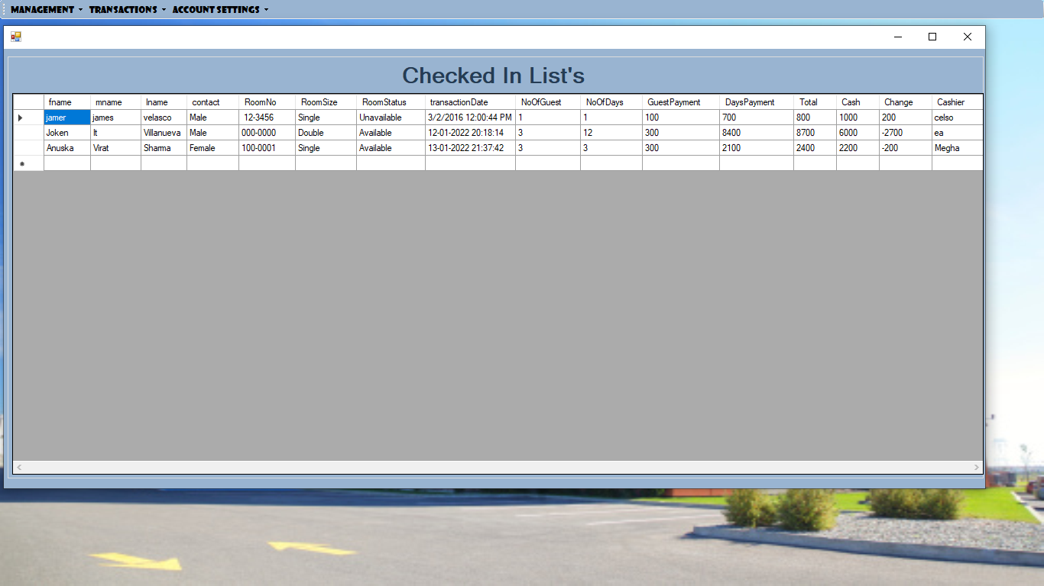
Checked In List Form – It Displays Checked In Record of Guest.

Slide 21
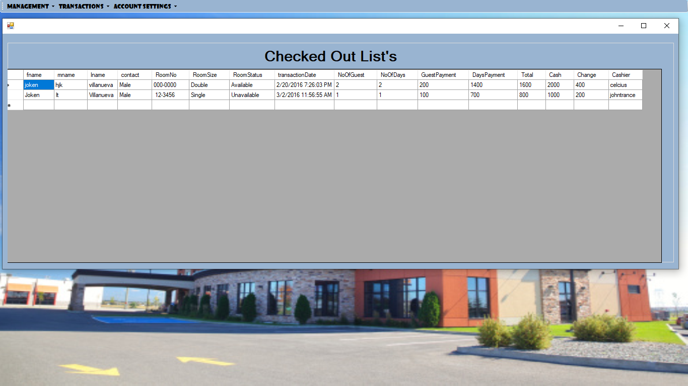
Checked Out List Form – It Displays Checked Out Record of Guest.

Slide 22
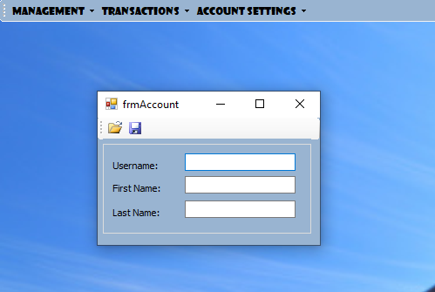
Add User Form : - It add new User.

Slide 23
Advantages
Keeping all the information about the customer and Checked In and Checked Out records in one place.
Reduce manual work.
Can remove unused data.
Automates daily operational workflow
Facilitates communication.
Automates finances and maintenance.
Decreases chances of misunderstanding.

Slide 24
Disadvantages
The system needs more elaborative technicality for its inception and evolution. And more than one user can not the system as the same time.
If one staff mistypes the information than the guest might get angry. If there is a power failure, while making a reservation than the staff must redo the whole reservation. When night auditing is being done all other user’s must be logged off.
Guest
1. If there is a power failure while making a reservation, all the information has to be given again
2. If there is a power cut while there is a check-in or check-out, the guest need to wait for full server start up, which make him angry.

Slide 25
Staff
1. If one staff mistypes the information than the guest might get angry
2. If there is a power failure, while making a reservation than the staff must redo the whole reservation.
3. When night auditing is being done all other user's must be logged off
4. If there is a virus attack the stored information can be corrupt and the wrong information may be given to the guest which might make him angry.
Hotel
1. All the staff needs to be trained on the software
2. The software needs to be renewed each year
3. High risk of virus attack as the systems are connected to the internet most of the time
4. If there is a virus attack the stored information might get corrupt
5. If there is a power failure, the hotel runs a high risk of loosing all the stored information
6. If night auditing is missed one day there might be a distraction the next day

Slide 26
Conclusion
In conclusion, User can store a large amount of data in one place can store in cloud for security purpose. It is used to easily search any tenant records.
And it was wonderful learning experience for while working on this project. This project took us through the various phases of project development and give use real insight into the world of software engineering.
With the conclusion of our project I hope that my project will proved helpful and will help to the administrator to make examine the tenant records easy and error free.

Slide 27
Thank You!

